Slide 1
FYP5: Object Detection, Tracking and Suspicious Activity Recognition for Maritime Surveillance using Thermal Vision

Slide 2
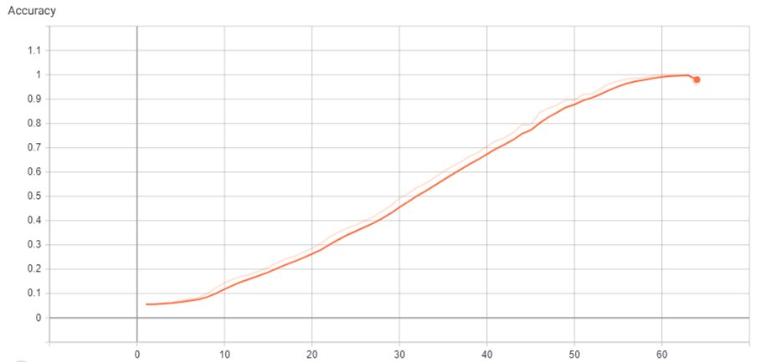
Research – Action Classification
Training of the Network on HMDB51 ​

Slide 3
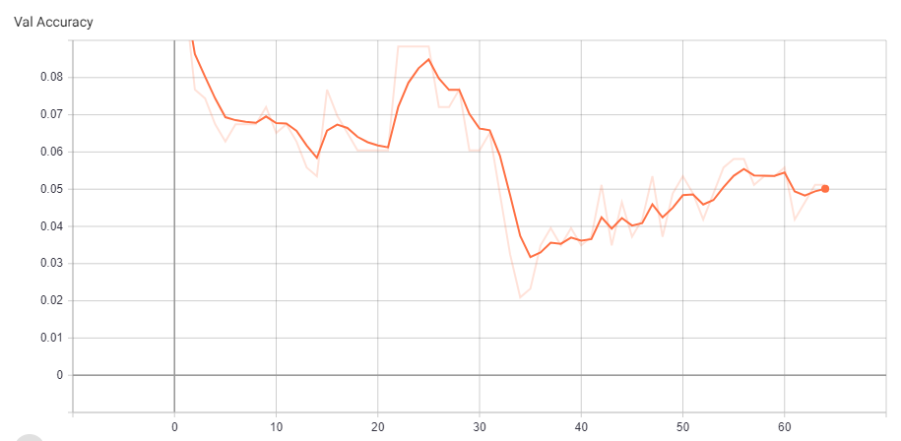
Validation Accuracy – Not generalizing

Slide 4
Possible Causes
Overfitting
Try a smaller model
Try using data augmentation
Not capturing temporal information –
HMDB51 is a scene-related dataset: The scenes contain a lot of information about the action.
Use a scene-independent dataset (Kinetics400, Something-something)
Train only the differential blocks (The middle block which we propose)
Investigation into similar works to identify their training procedures

Slide 5
Alternatives to pursue
Temporal localization – same scene, but some sections of the video have actions, and some don’t: Model must learn how to discriminate between them

Slide 6

Tasks for next week
Working on the data loader to incorporate the augmentation techniques used in the publish
Working on the alternative proposed in previous slide

